Slide 1
GSL XXVI
Awards Presentation
April 30, 2017

Slide 2
Private Awards Presentation

Slide 3
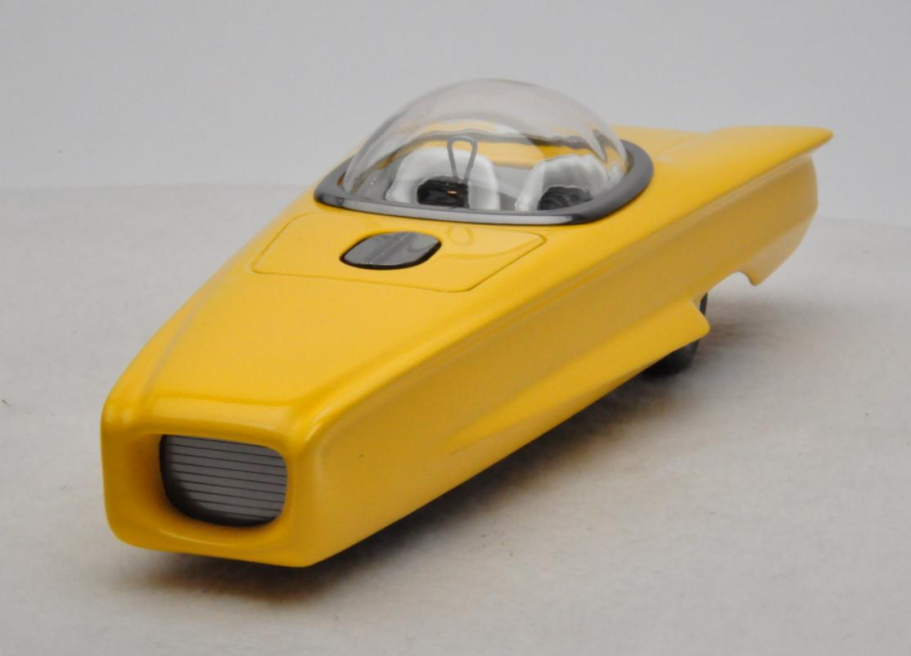
Klingon Kruiser Award
Charles Hepperle – 1960 Ford Wedge
Private Award

Slide 4
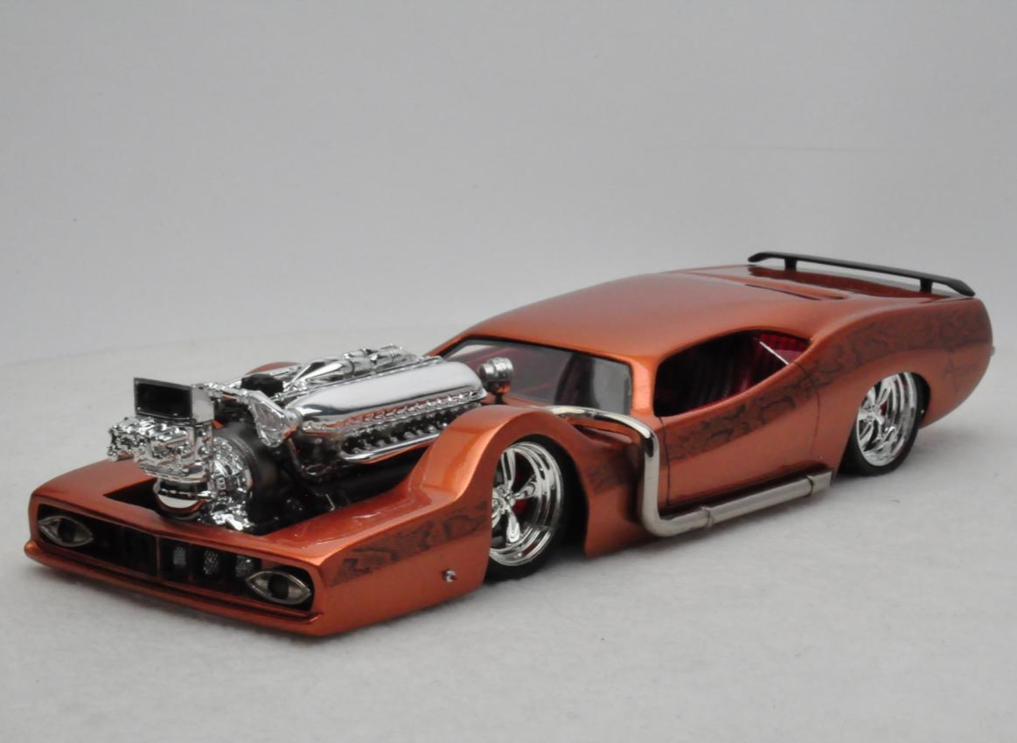
Ricky Couch Show Rod
David Morton – “Bad Snake” Barracuda
Private Award

Slide 5
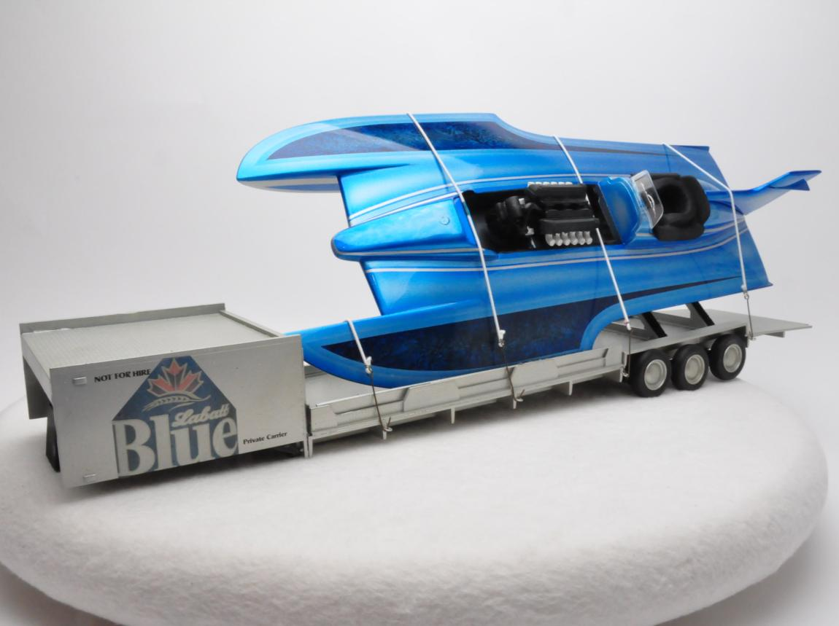
Model Cars Magazine Best Use of Color
Pat Bibeau – La Batt’s Blue Speed Boar
Private Award

Slide 6
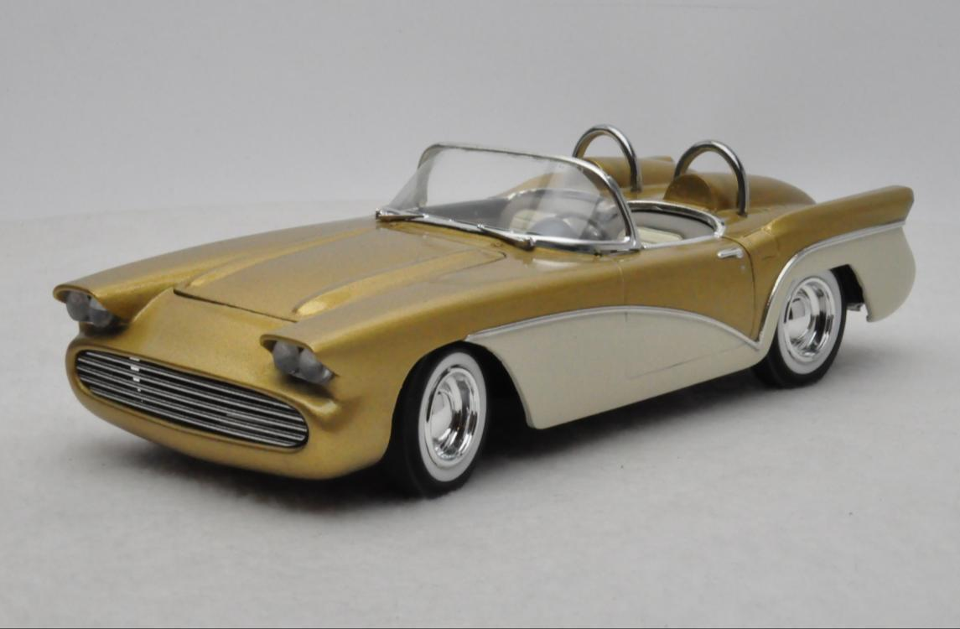
MCMA “Bob Barnett Memorial Award”
Mike Laliberte – 1960 Corvette Custom
Private Award

Slide 7
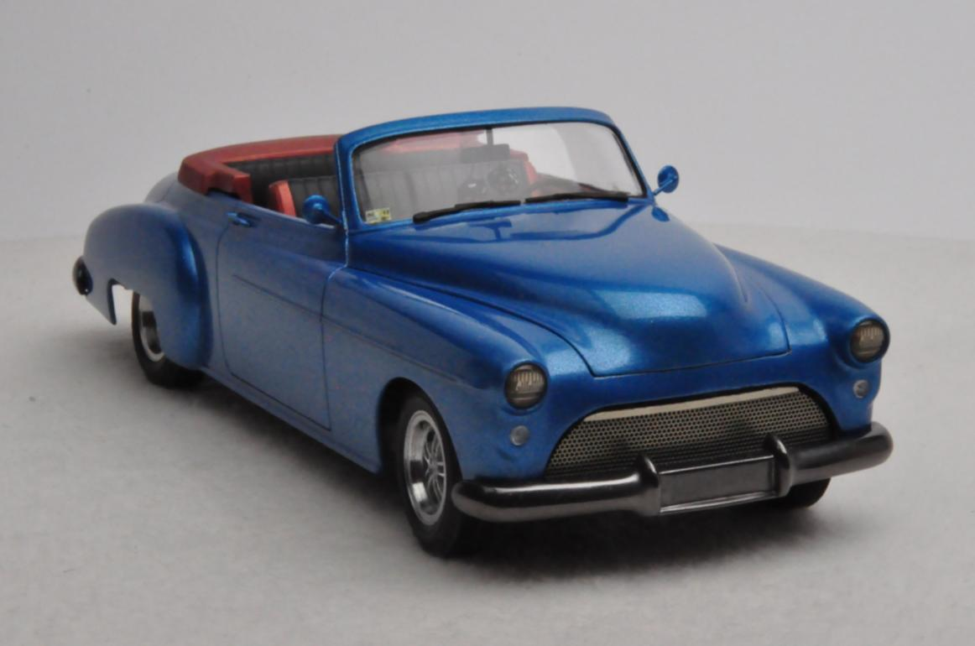
Goodguys Rod and Custom Association Model D’Elegance
Paul Anagnostopolous – ‘50 Oldster Custom
Private Award

Slide 8
Ed Roth Memorial Award
Private Award

Slide 9
The Moose is Loose Award
Private Award

Slide 10
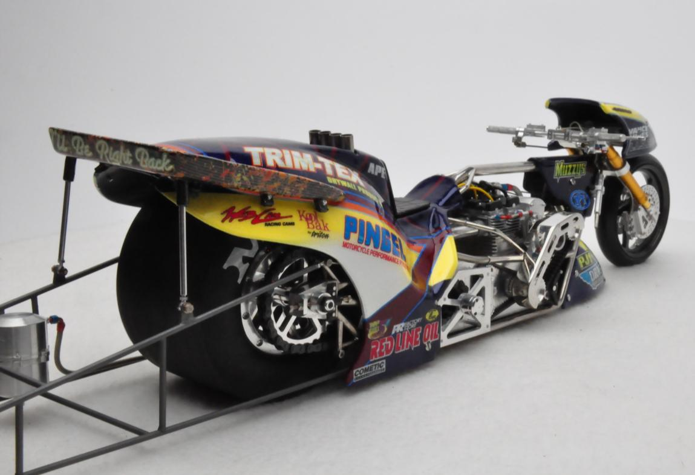
“The Augie” Best Machining / Metal Work
Dirk Joseph – Top Fuel Bike
Private Award

Slide 11
GSL Class Awards

Slide 12
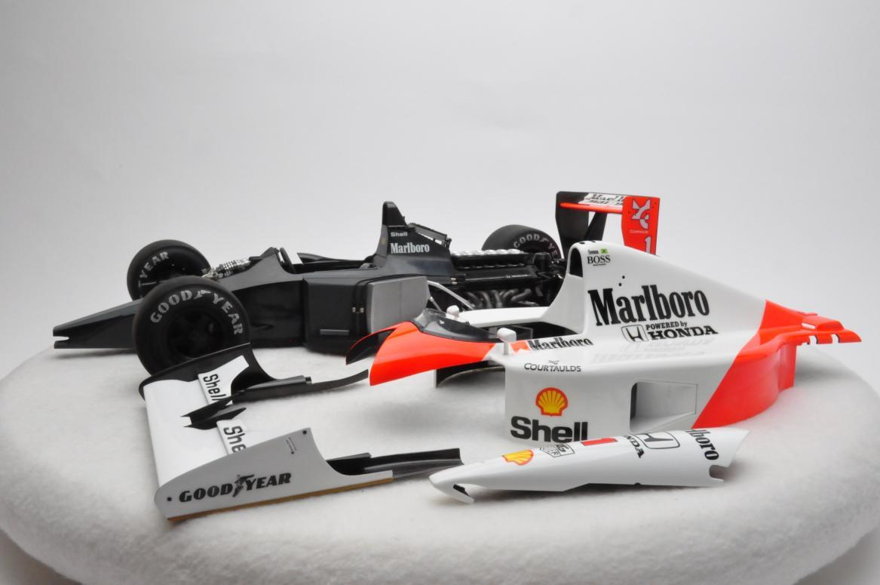
Fourth Place
Steve Keck – McLaren MP4
Box Plus

Slide 13
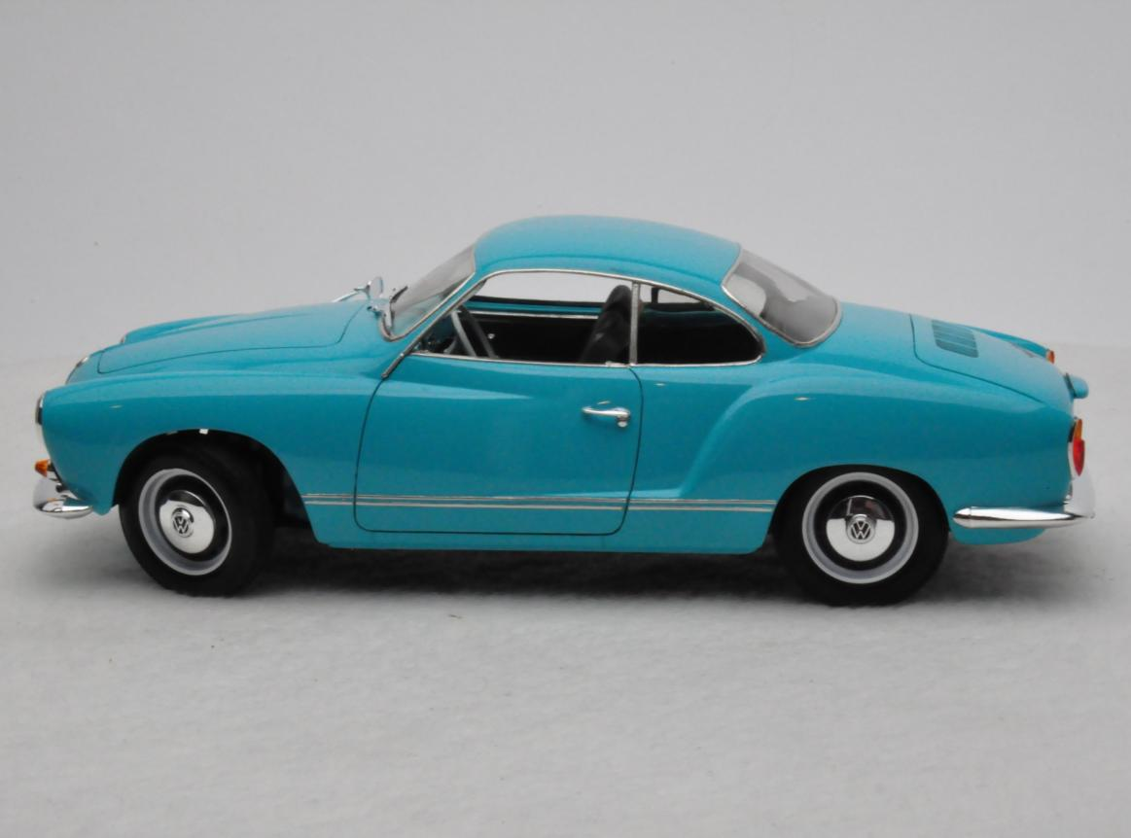
Third Place
David Morton – 1966 Karman Ghia
Box Plus

Slide 14
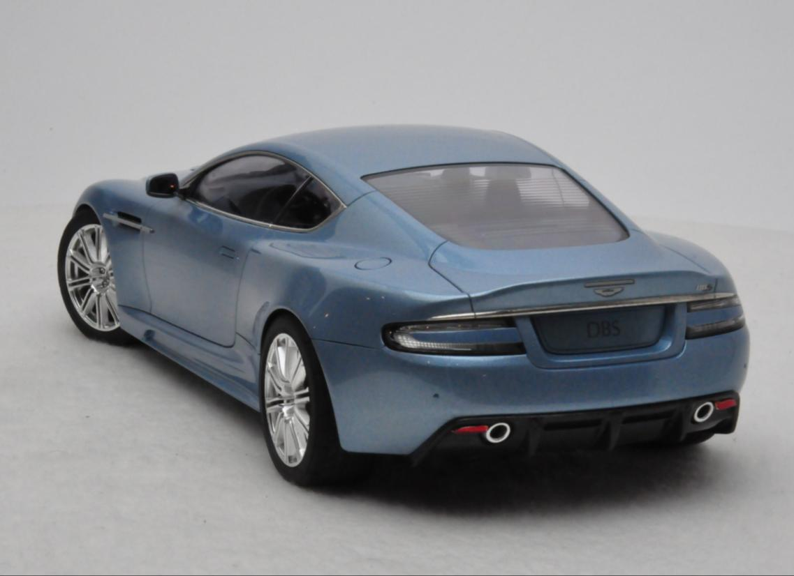
Second Place
David Morton – Ice Blue Aston Martin DBS
Box Plus

Slide 15
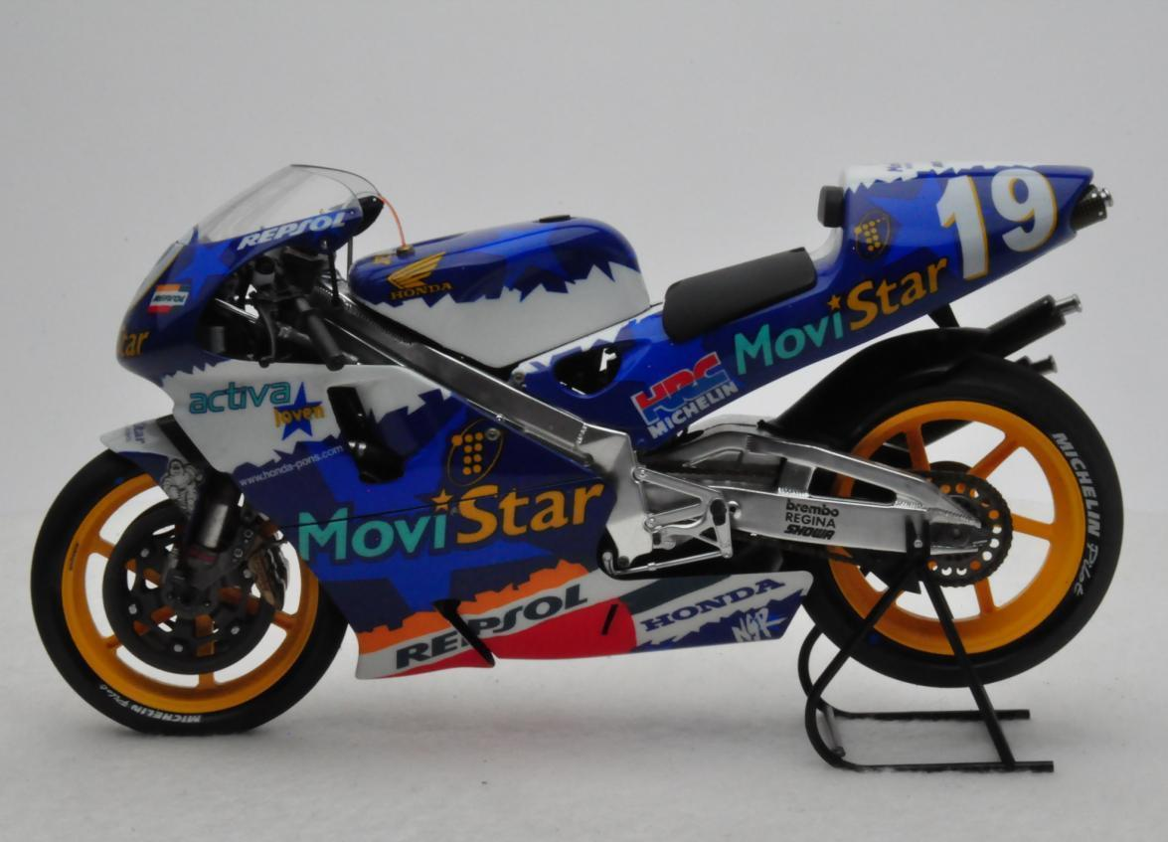
Best in Class
Charbel Perez – Honda NSR 500
Box Plus

Slide 16
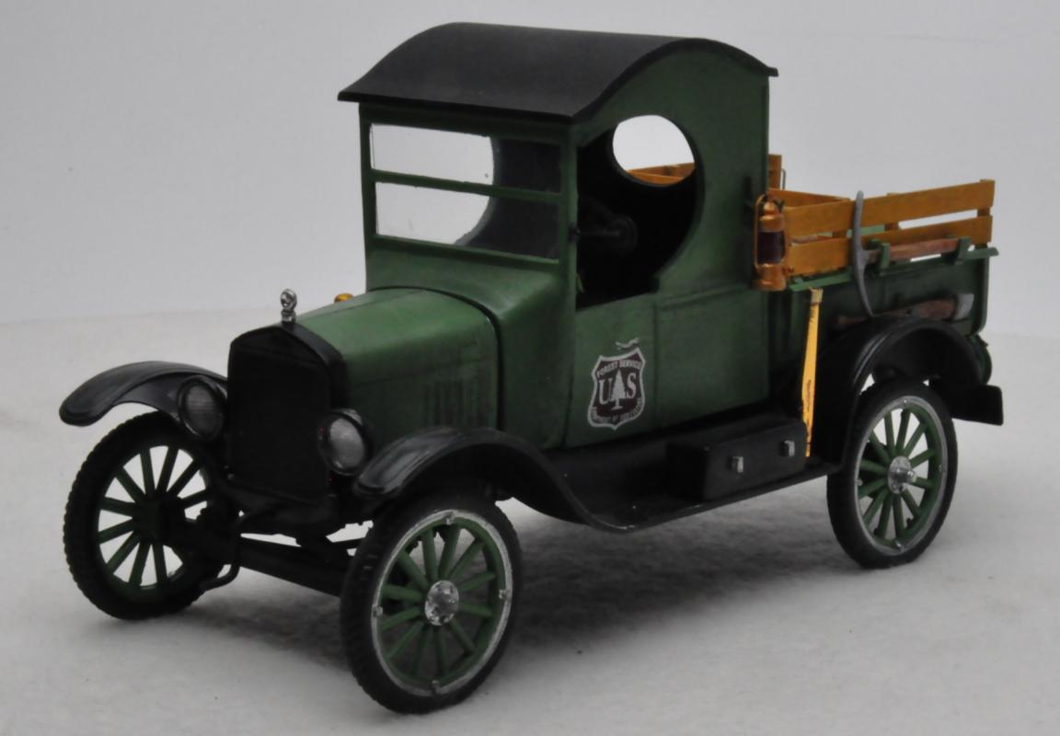
Fourth Place
Jimmie Harris – 1925 Ford Forest Service Truck
Commercial & military, Light Duty

Slide 17
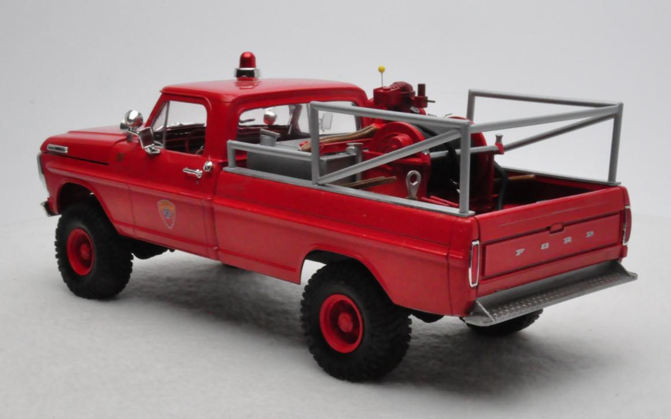
Third Place
Don Berry – 1971 Ford Fire Department Grass Truck
Commercial & military, Light Duty

Slide 18
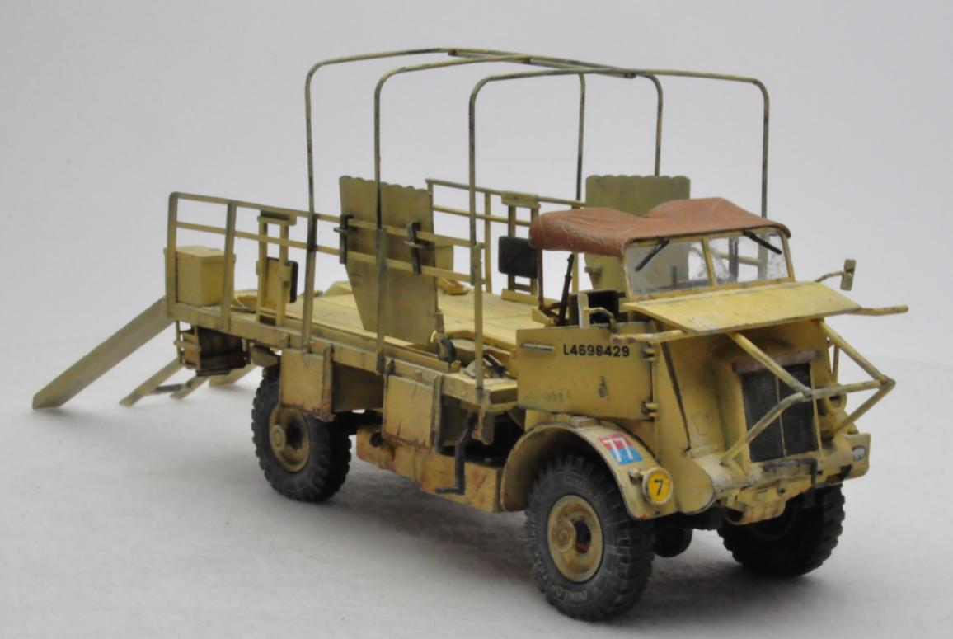
Second Place
Gary Moore – Bedford QL “Portee”
Commercial & military, Light Duty

Slide 19
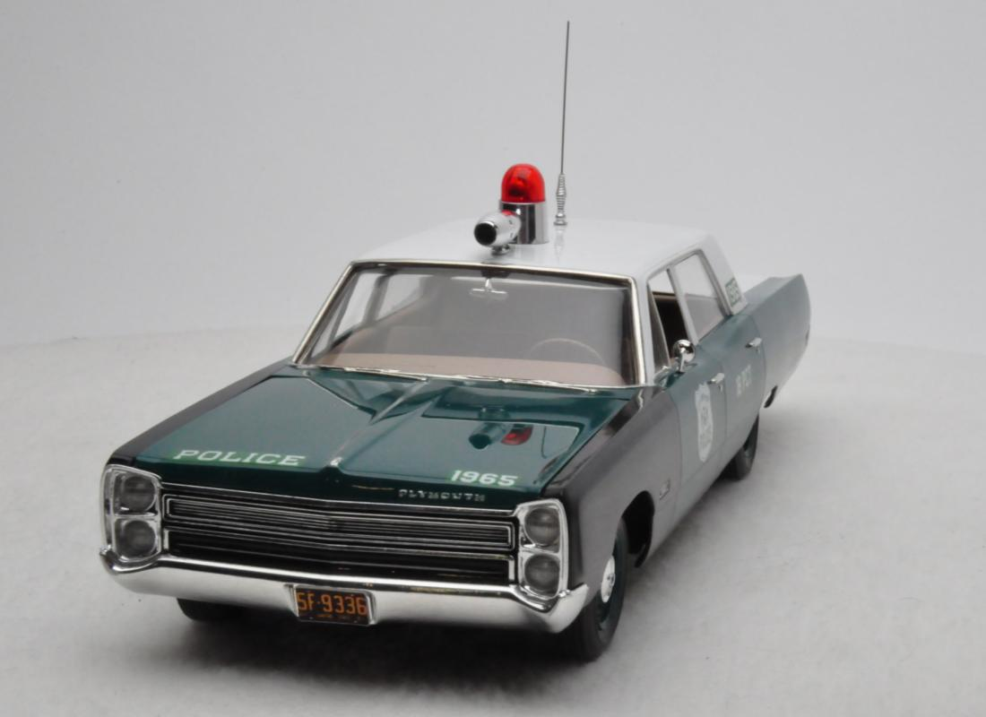
Best in Class
John Baczuk – 1968 Plymouth NYC Police Car
Commercial & military, Light Duty

Slide 20
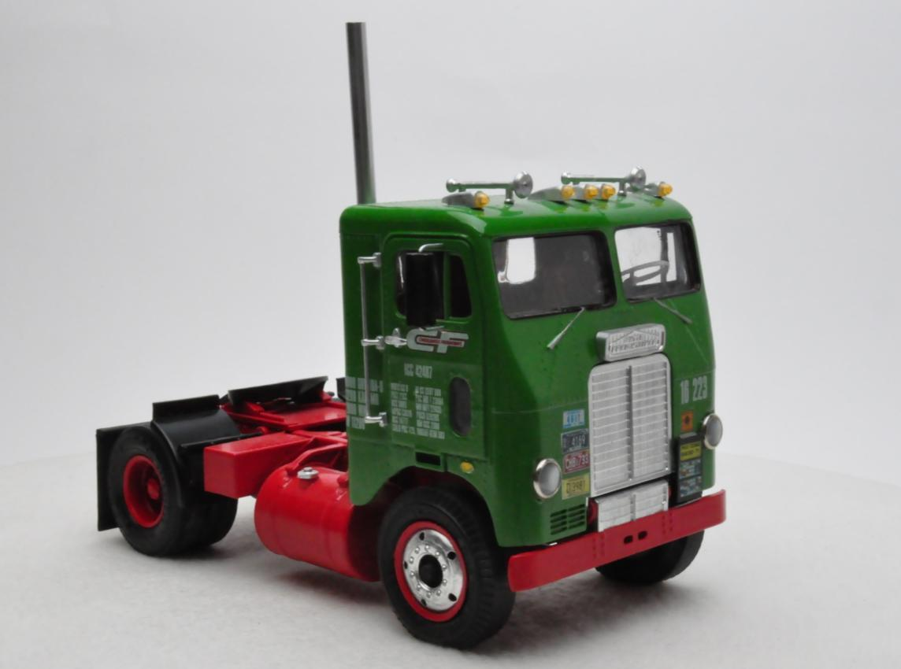
Fourth Place
Lee Hartman – Green & Red Freightliner SD
Commercial & military, Heavy-Duty

Slide 21
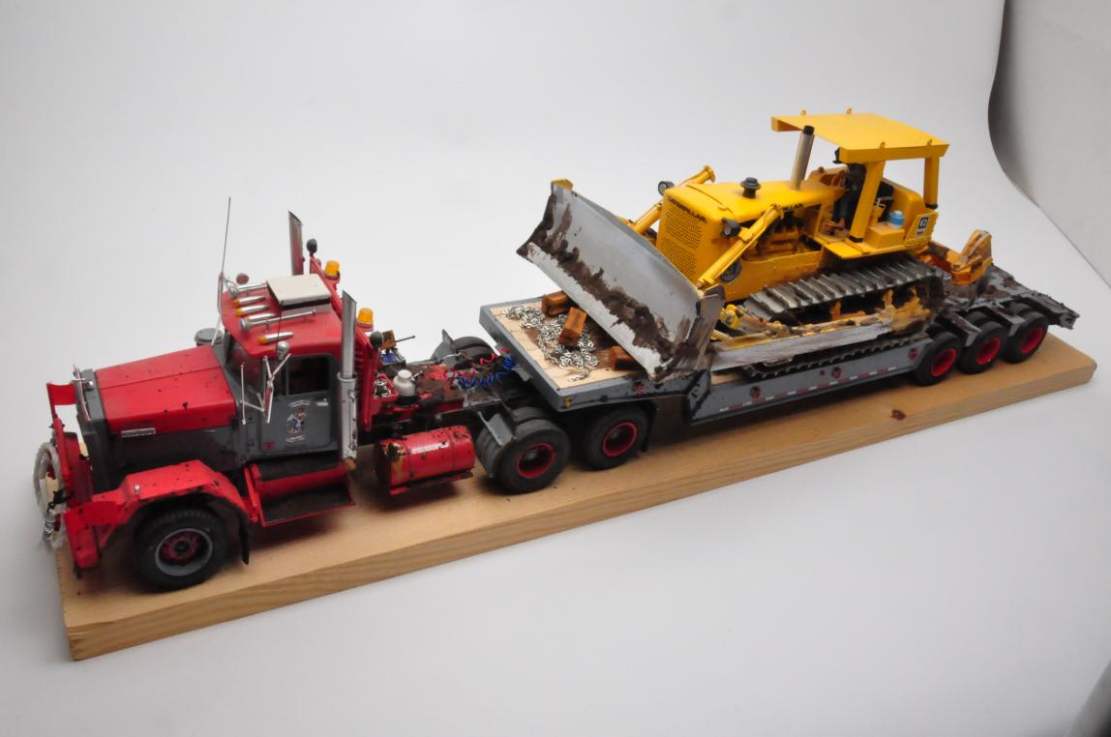
Third Place
Gene Hunting – Alaskan Dozer Hauler
Commercial & military, Heavy-Duty

Slide 22
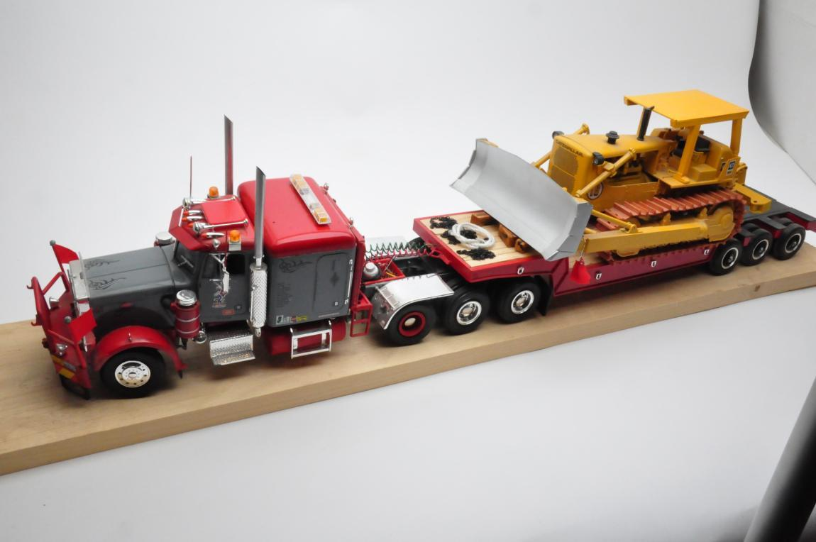
Second Place
Gene Hunting – Peterbilt Dozer Hauler
Commercial & military, Heavy-Duty

Slide 23
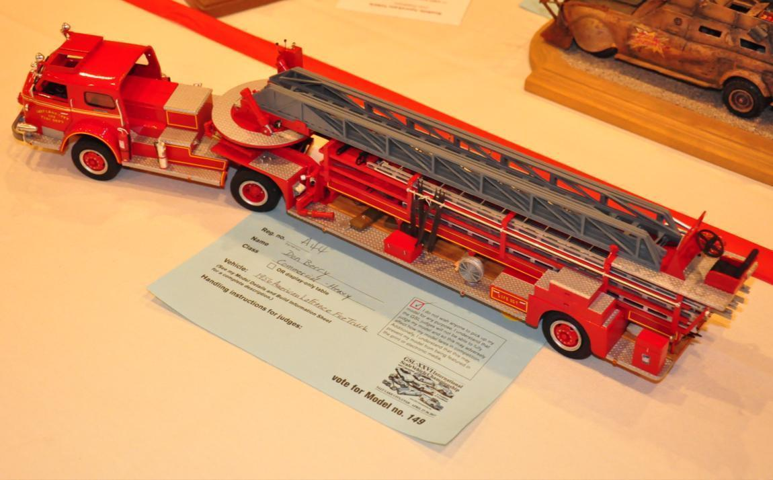
Best in Class
Don Berry – 1956 American La France Fire Truck
Commercial & military, Heavy-Duty

Slide 24
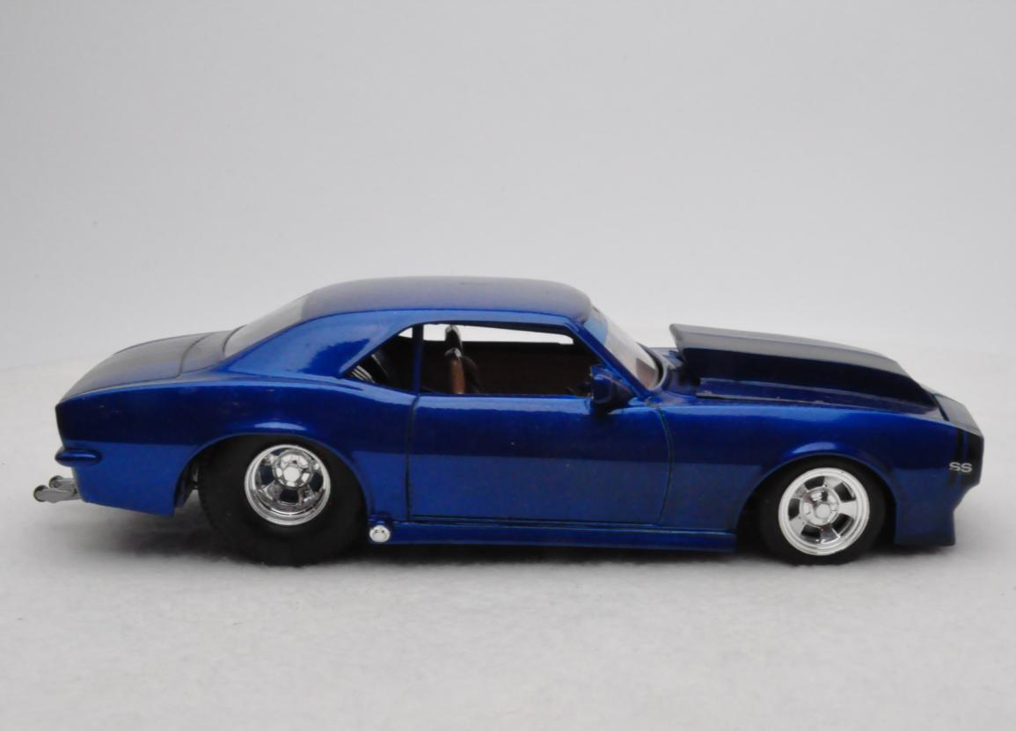
Third Place
Michael Dubbelman – Blue Pro Street Camaro
Common Kit
Revell 1967 Camaro

Slide 25
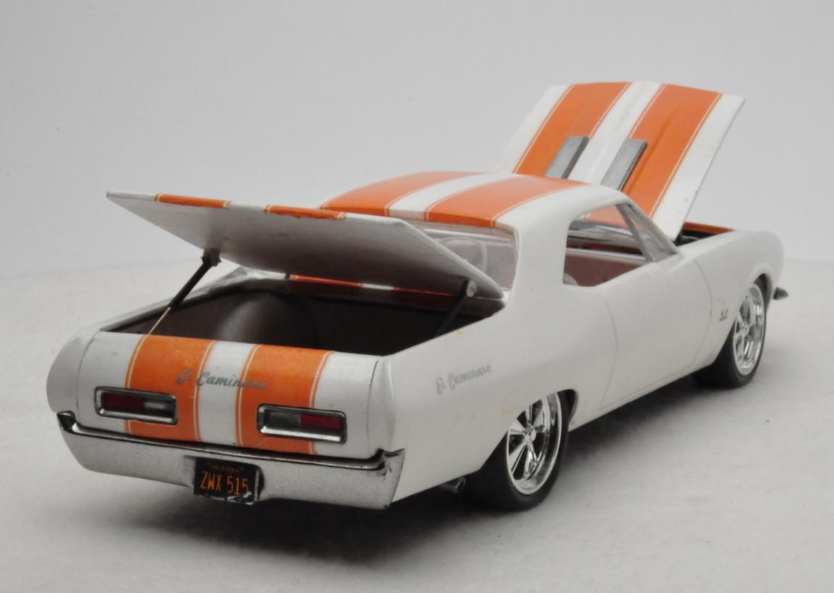
Second Place
Curt Raitz – 1967 El Caminaro
Common Kit
Revell 1967 Camaro

Slide 26
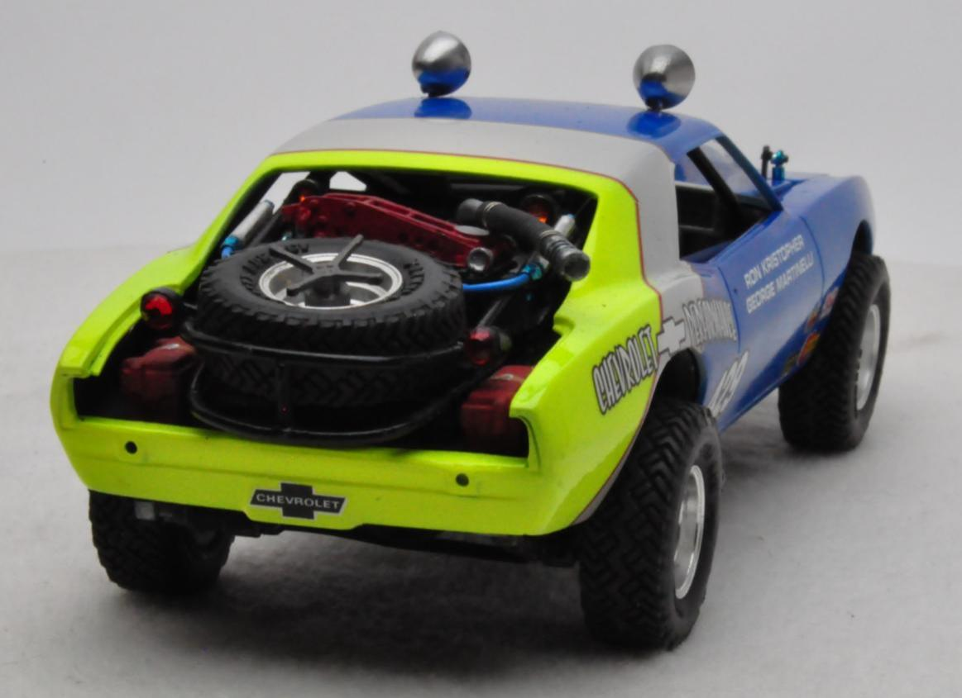
Best in Class
Claude Jones – Blue, Silver & Green Off-Road Racer
Common Kit
Revell 1967 Camaro

Slide 27
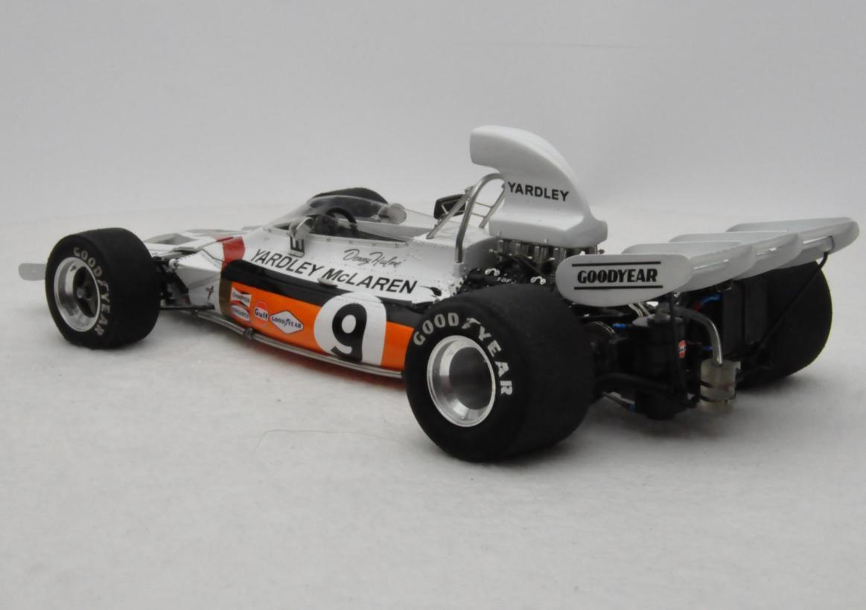
Fourth Place
Jeff Wallen – Yardley McLaren M-19
Competition: Circle Track/Road Course

Slide 28
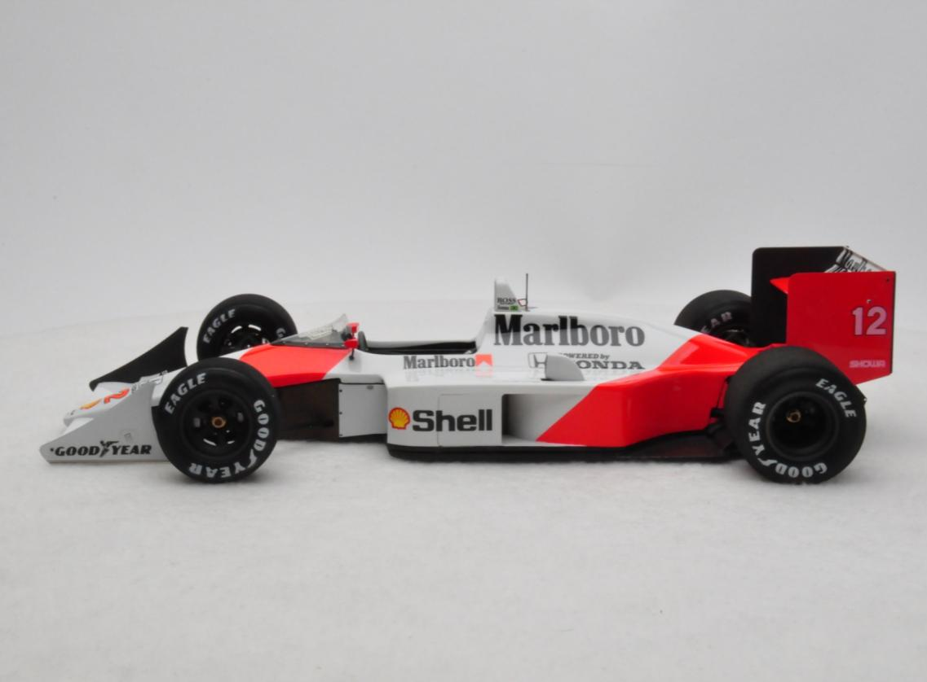
Third Place
Ricardo Hernandez – McLaren MP4-4 White & Red
Competition: Circle Track/Road Course

Slide 29
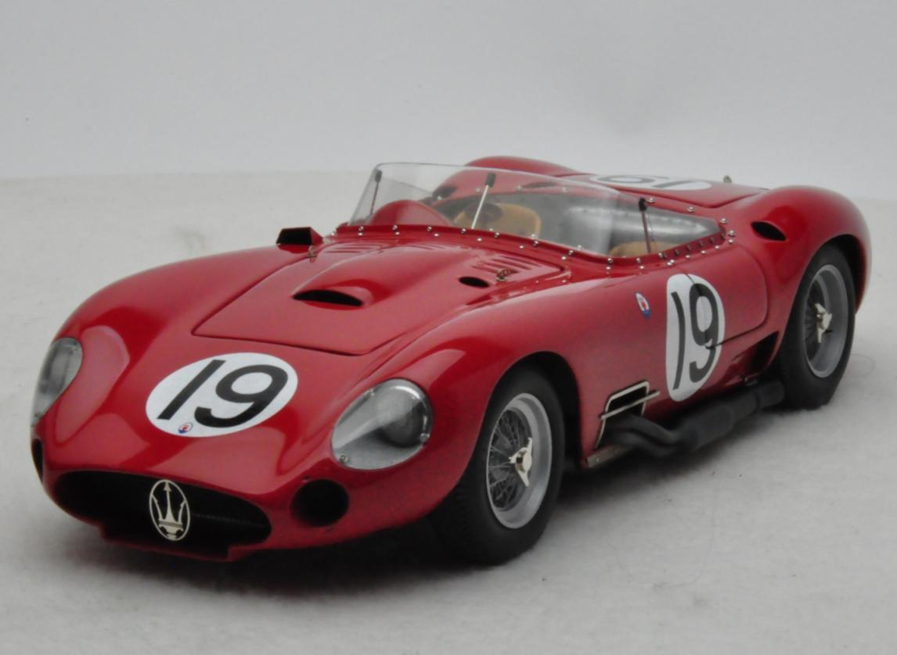
Second Place
Vince LoBosco – Red 1957 Maserati 450 S
Competition: Circle Track/Road Course

Slide 30
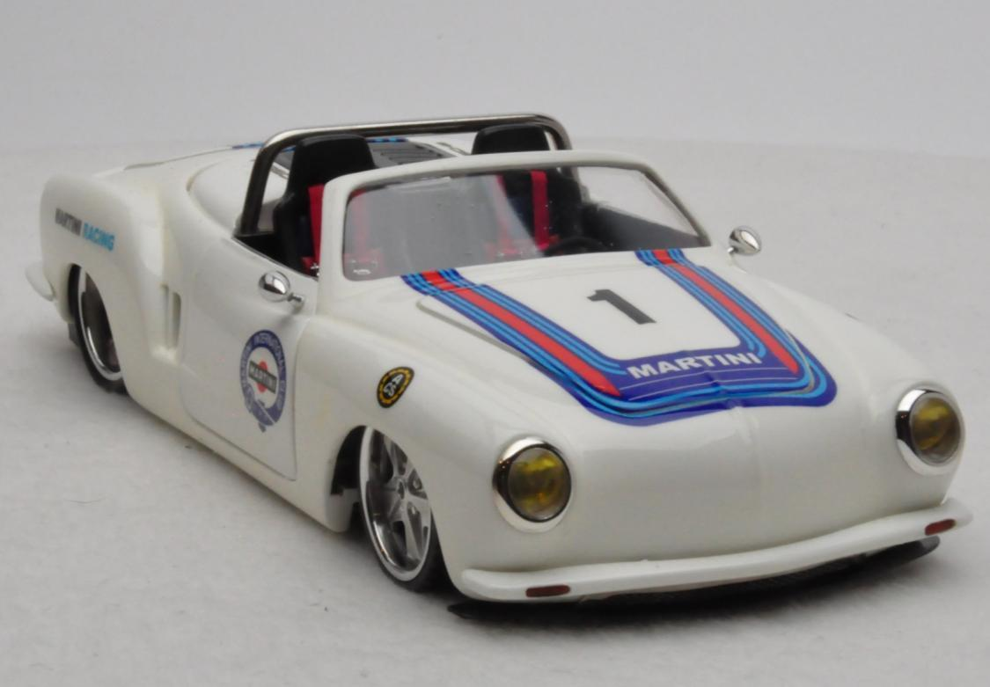
Best in Class
Dirk Joseph – White Ghia Porsche
Competition: Circle Track/Road Course

Slide 31
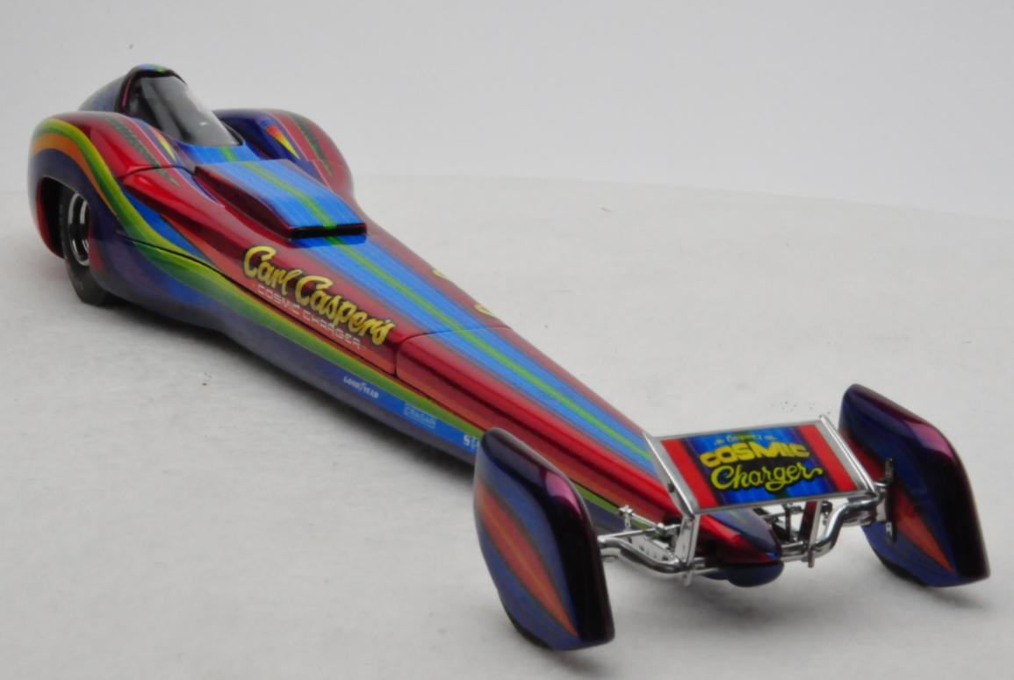
Fourth Place
John Teresi – Cosmic Charger
Competition: Drag

Slide 32
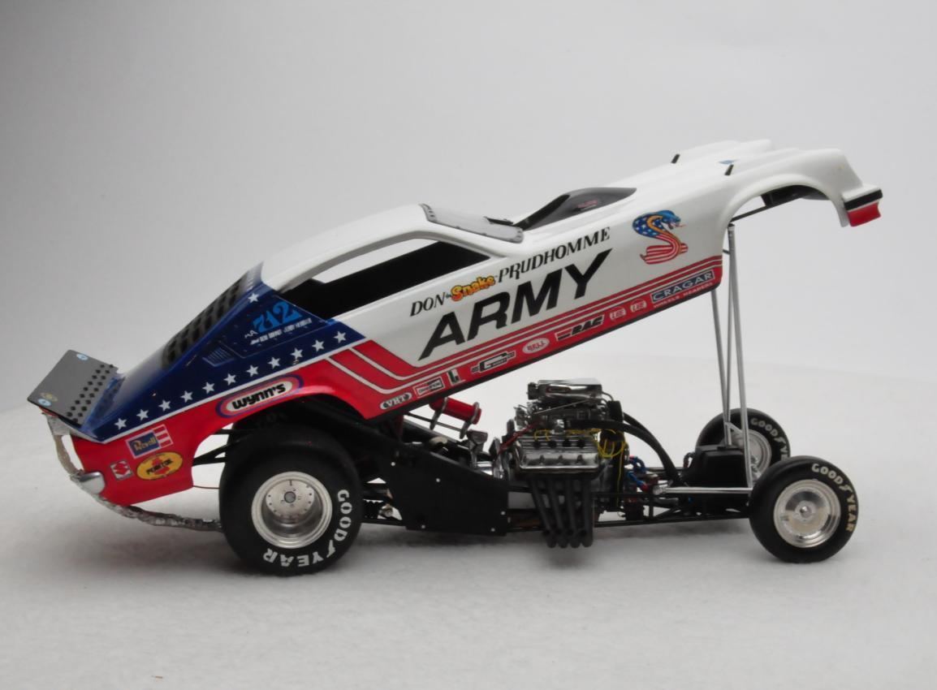
Third Place
Simon P. Rivera-Torres – Army Vega Funny Car
Competition: Drag

Slide 33
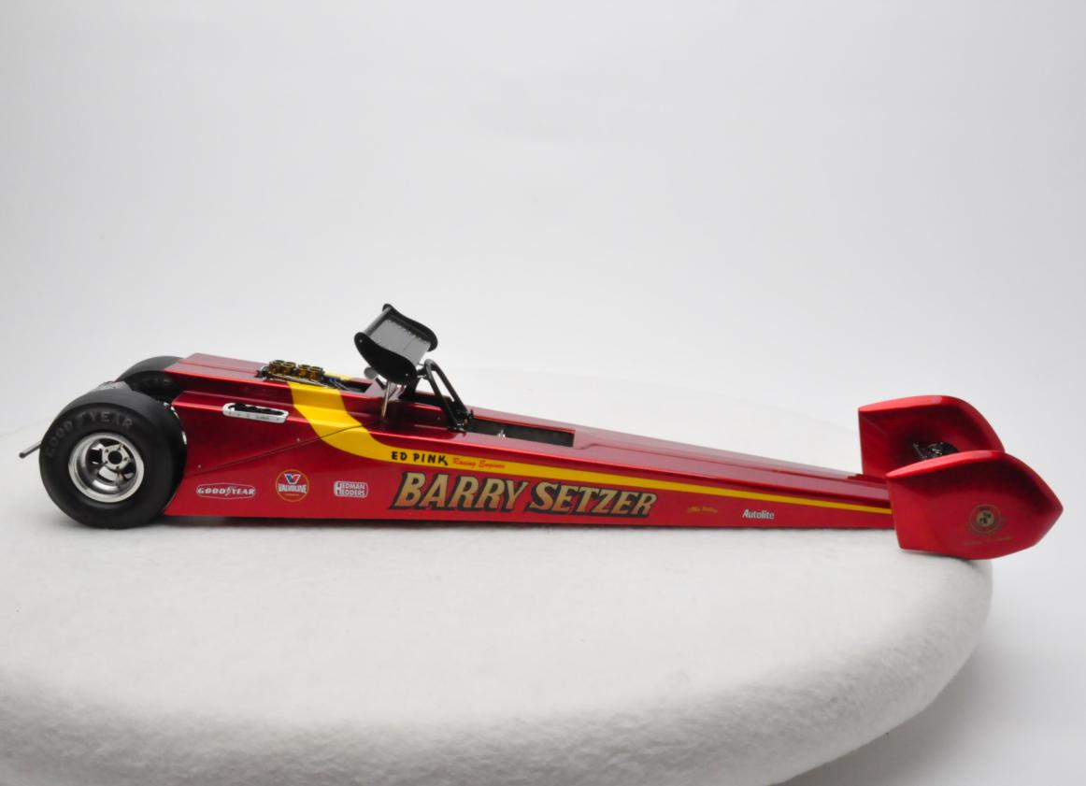
Second Place
John Teresi – Barry Setzer Top Fuel Dragster
Competition: Drag

Slide 34
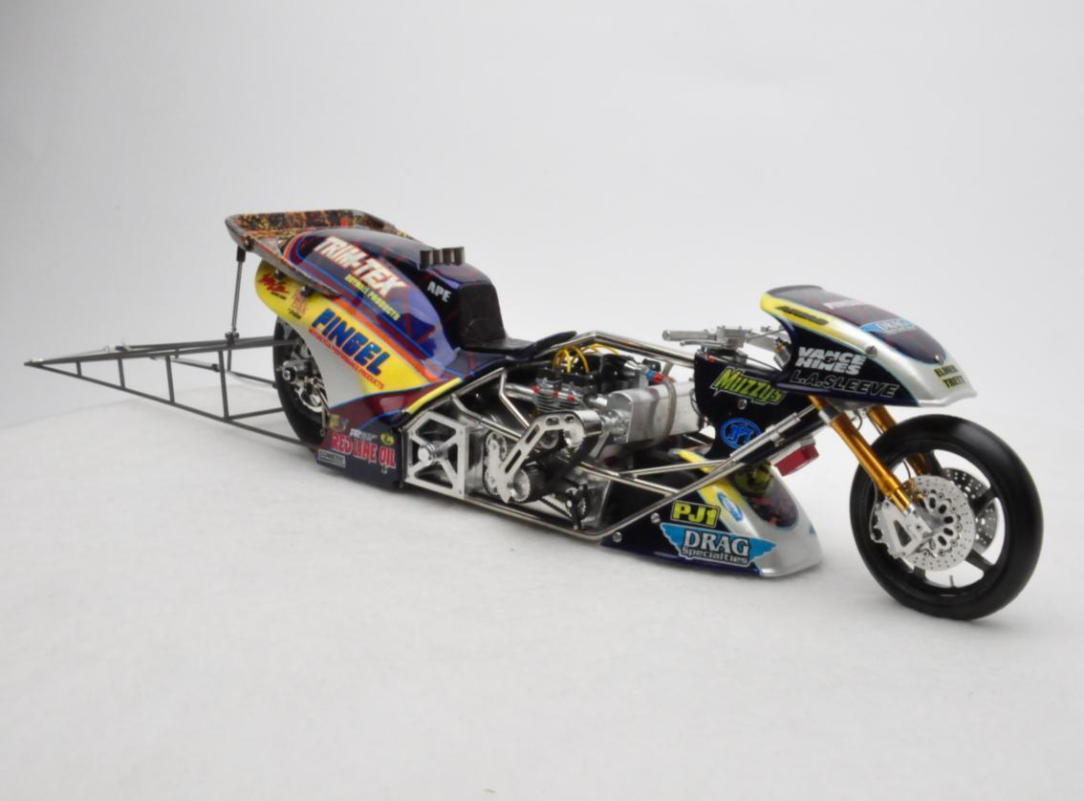
Best in Class
Dirk Joseph – Top Fuel Motorcycle
Competition: Drag

Slide 35
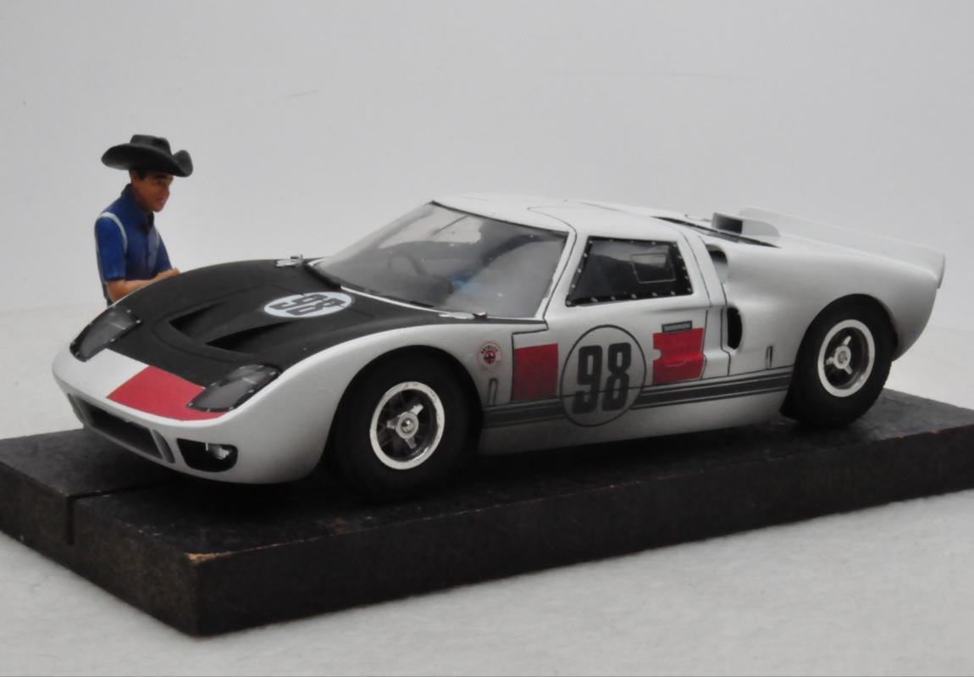
Third Place
Jairus Watson – White Ford GT40 Mk II
Concours Slot Car

Slide 36
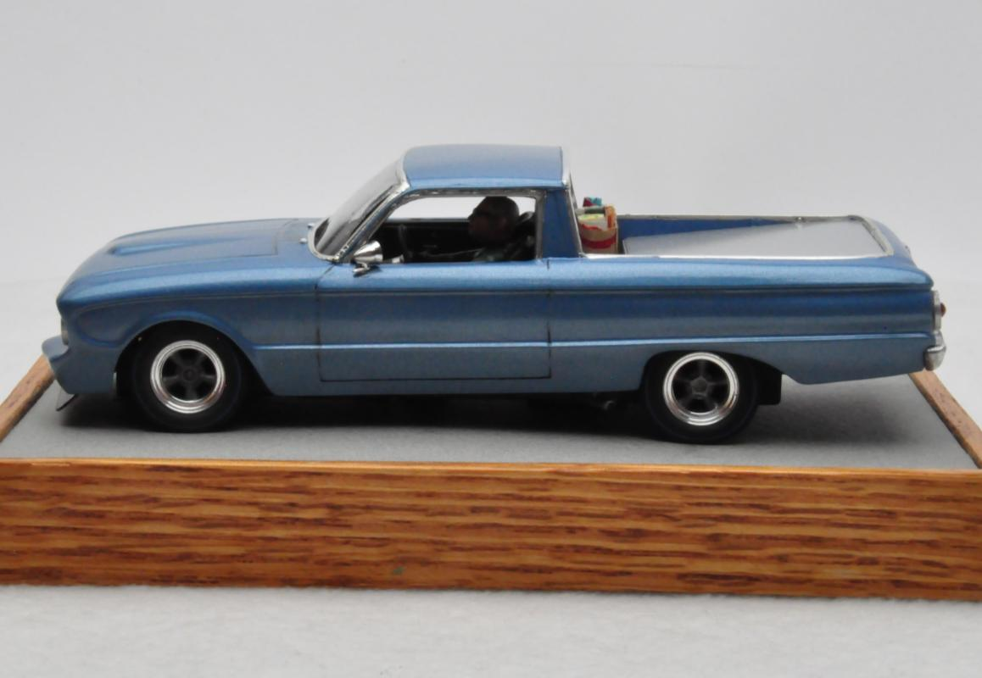
Second Place
Steve Roullier – Blue Ranchero
Concours Slot Car

Slide 37
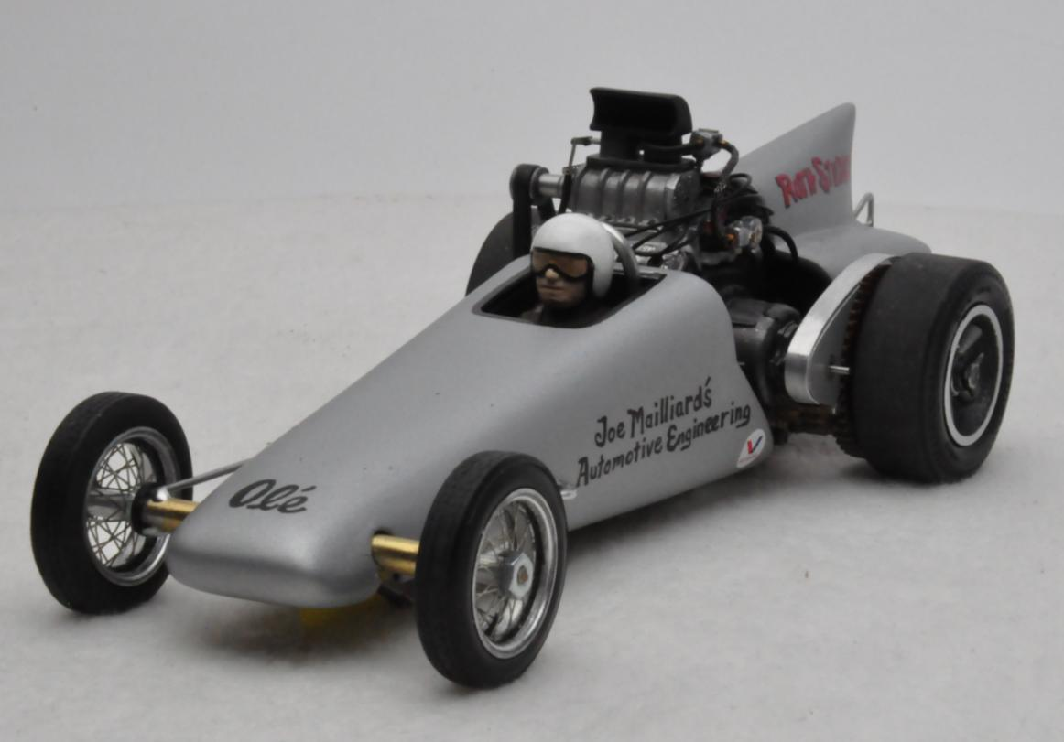
Best in Class
Don Strong – Sidewinder Dragster
Concours Slot Car

Slide 38
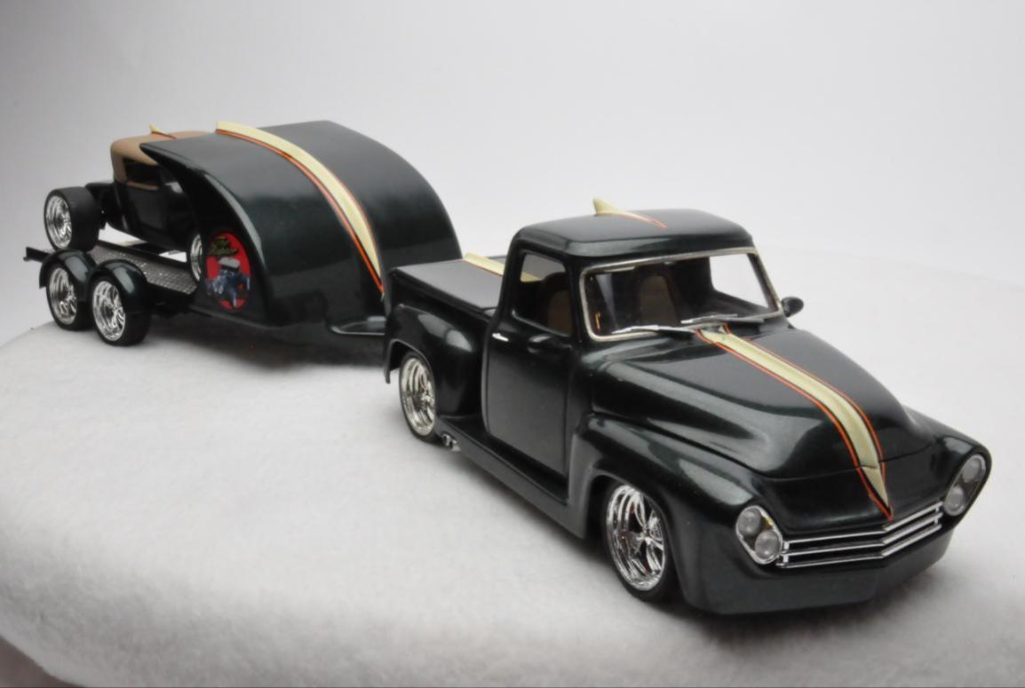
Fourth Place
Raul Perez – Dark Green Raptor Show Truck
Custom

Slide 39
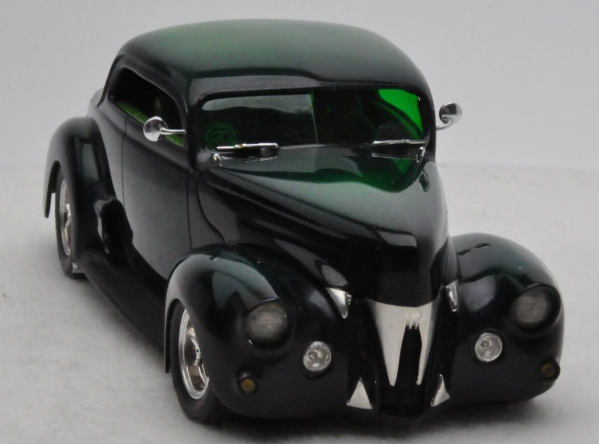
Third Place
John Z. Nichols – Dark Green St. Ed’s Rat Fink ‘40
Custom

Slide 40
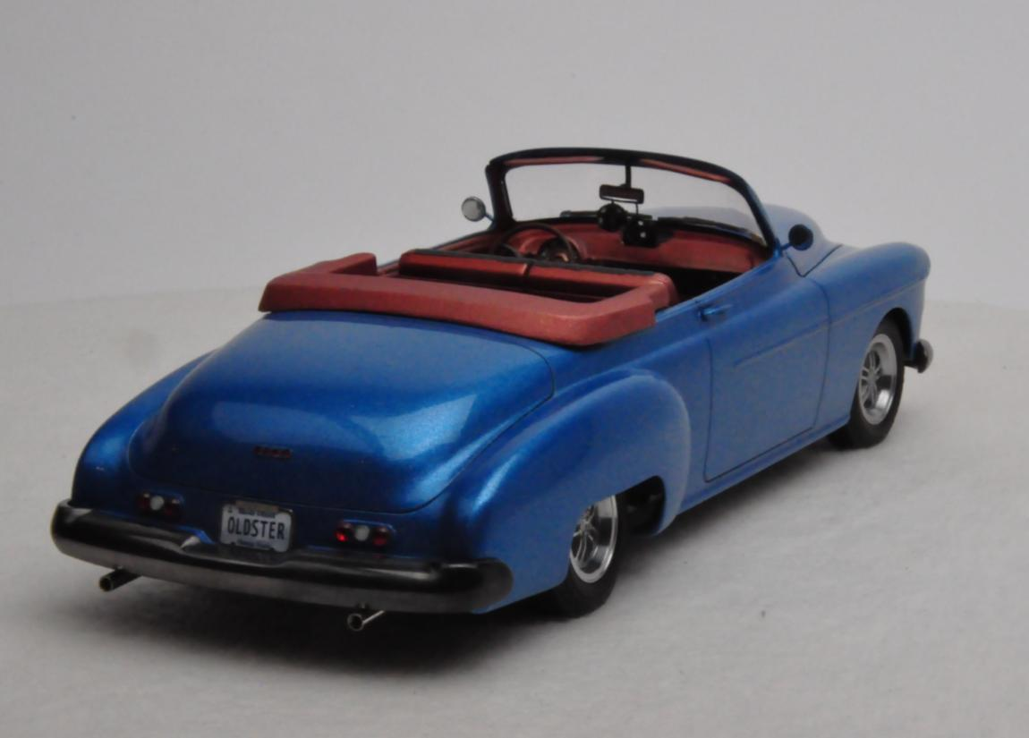
Second Place
Paul Anagnostopoulos – Blue ‘50 Olds Convertible
Custom

Slide 41
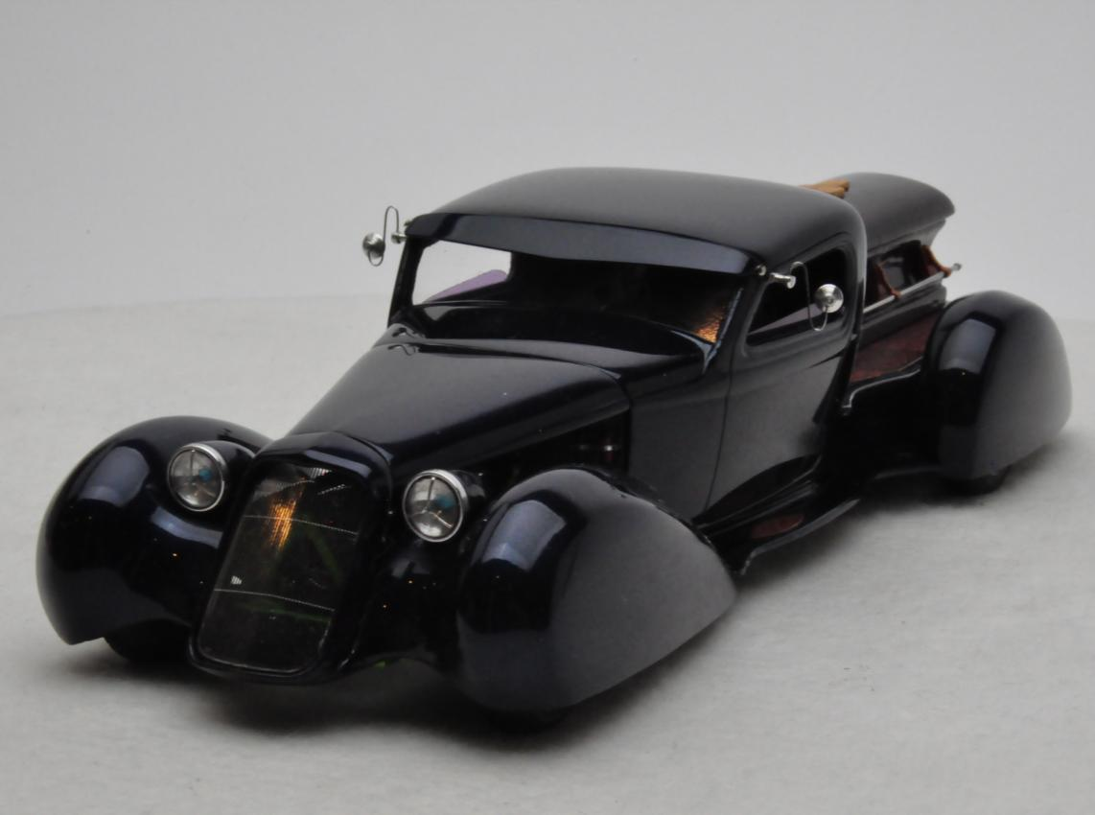
Best in Class
David Morton – Dark Blue 1932 Deco Duce – Coffin Hauler
Custom

Slide 42
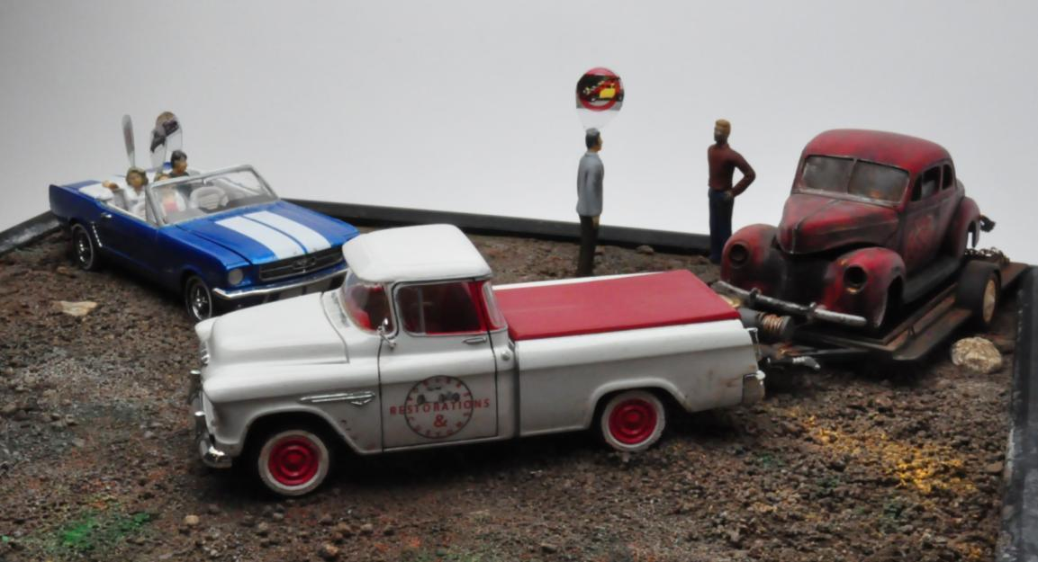
Third Place
Dave Hadley – Family Project
Diorama

Slide 43
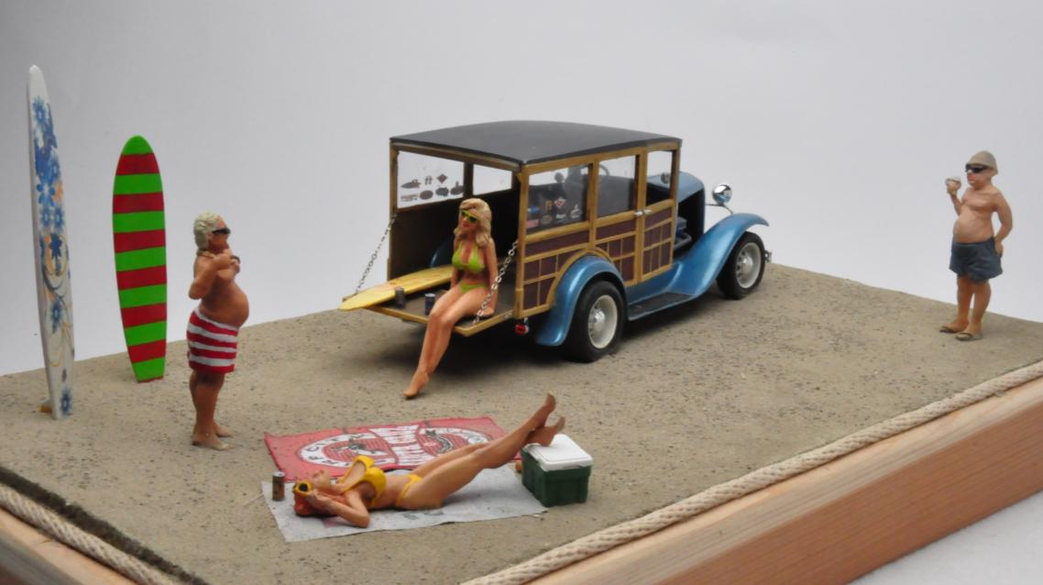
Second Place
Curt Raitz – Surf City + 50 Years
Diorama

Slide 44
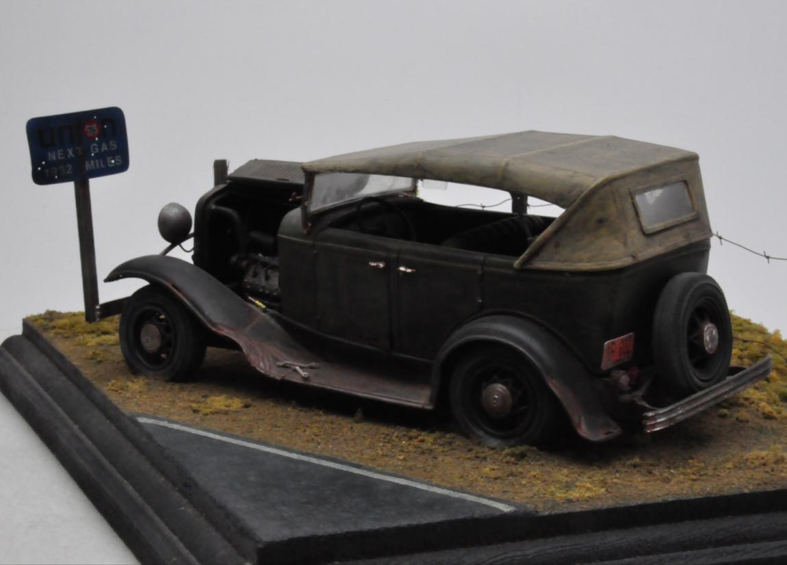
Best in Class
Raul Perez – Next Gas 1932 Miles
Diorama

Slide 45
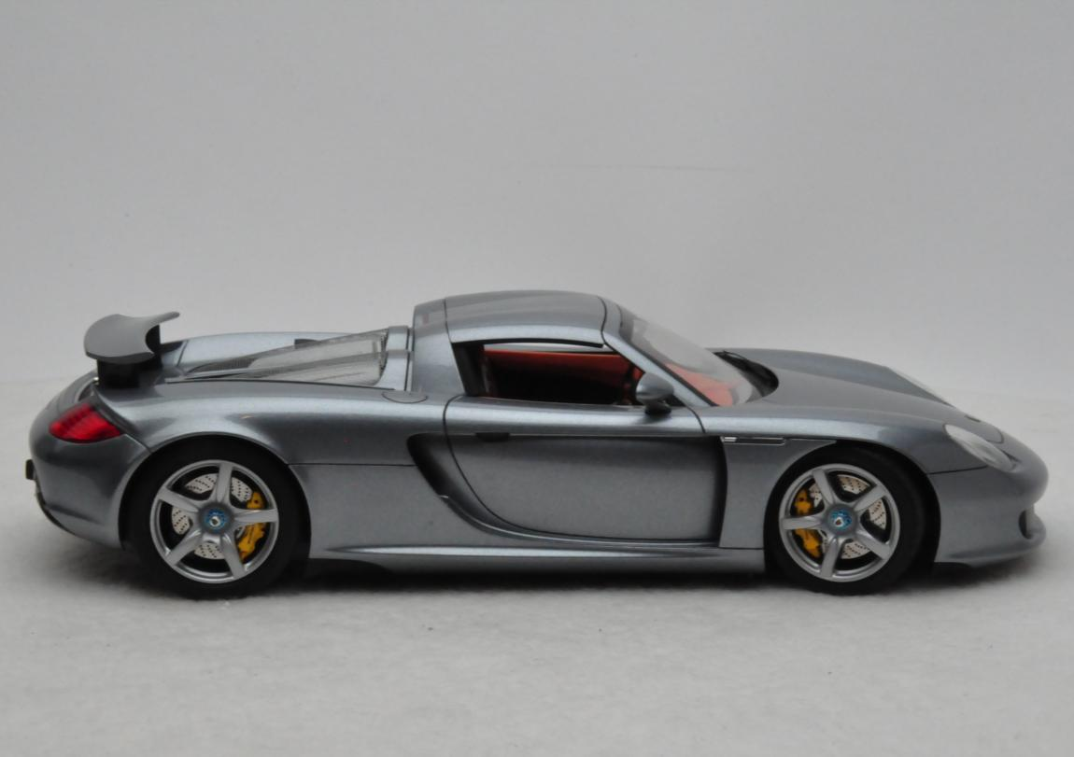
Fourth Place
Ricardo Hernandez – Metallic Gray Porsche Carrera GT
Factory Stock

Slide 46
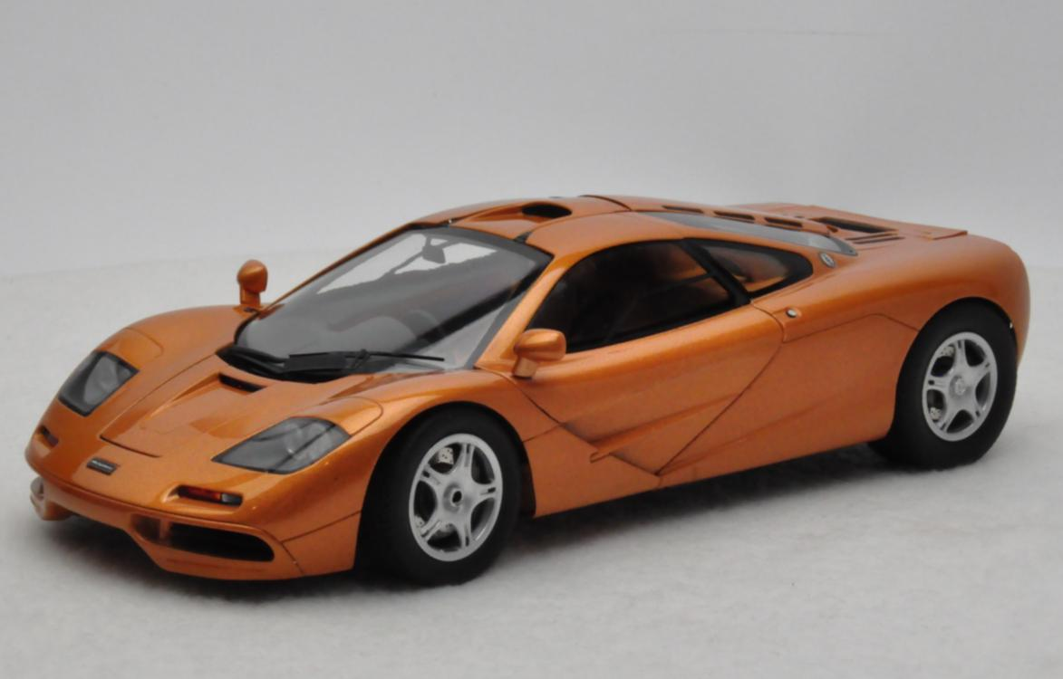
Third Place
Ricardo Hernandez – Metallic Bronze McLaren F-1
Factory Stock

Slide 47
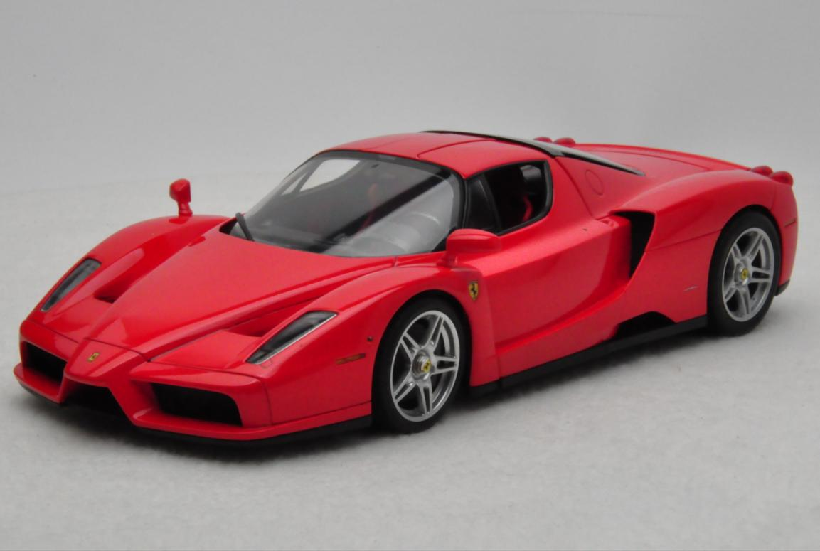
Second Place
Ricardo Hernandez – Red Enzo Ferrari
Factory Stock

Slide 48
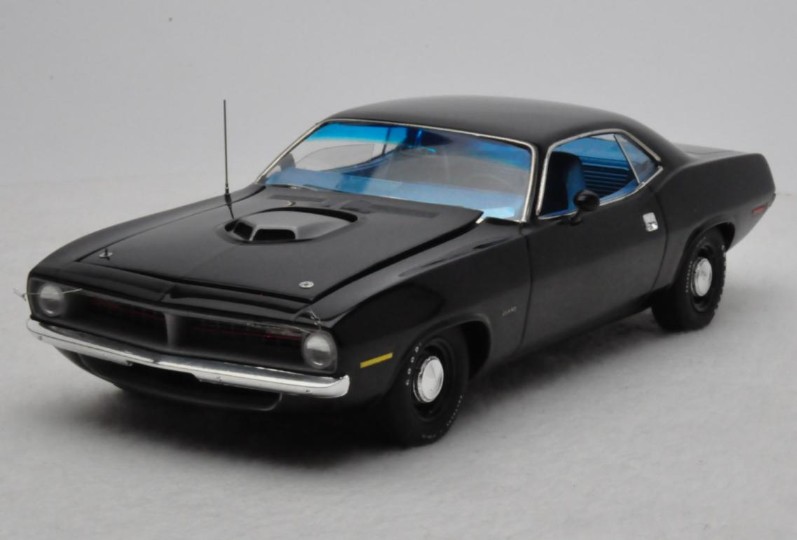
Best in Class
Tom Nungester – Black 1970 Cuda
Factory Stock

Slide 49
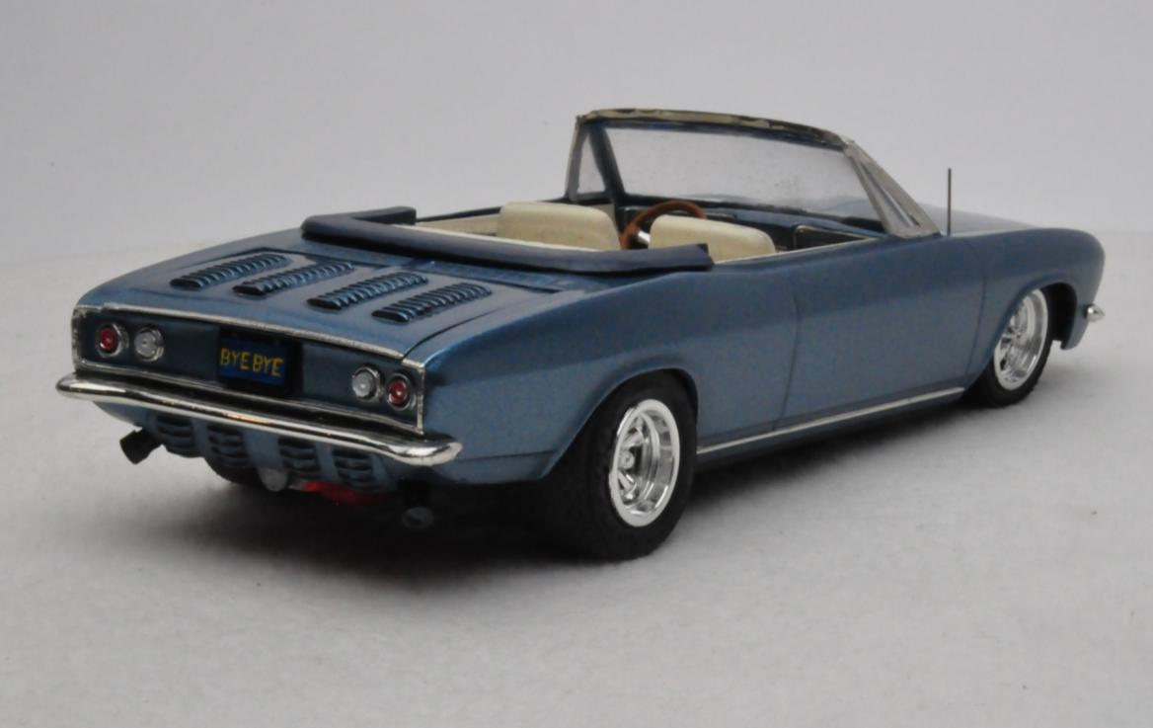
Fourth Place
Brad Phillips – Blue Corvair
Group 17
Round2 1969 Chevy Corvair

Slide 50
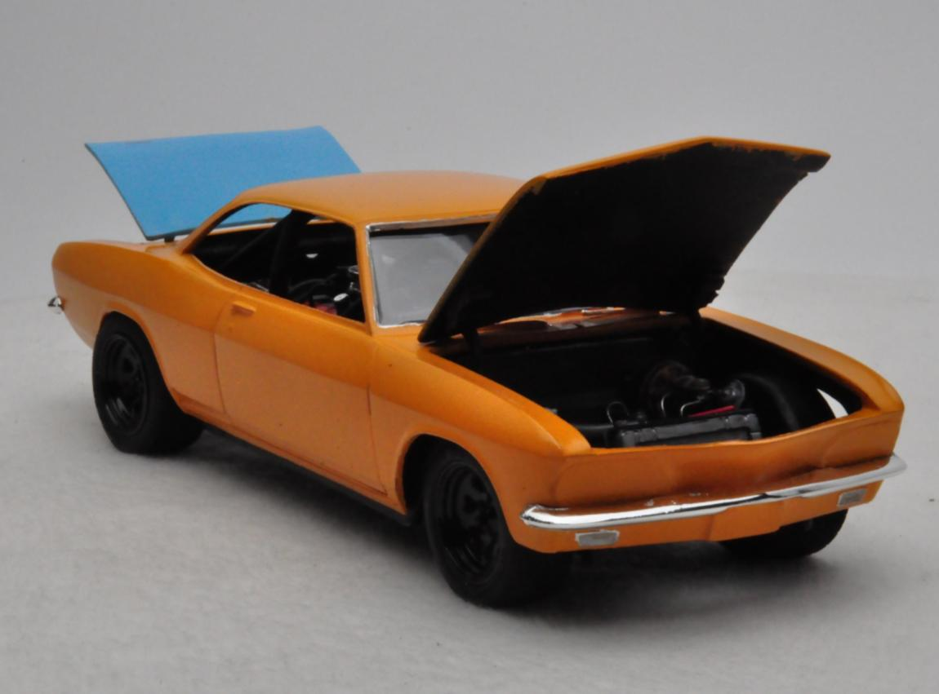
Third Place
Pryor Passarino II – Yellow Corvair
Group 17
Round2 1969 Chevy Corvair

Slide 51
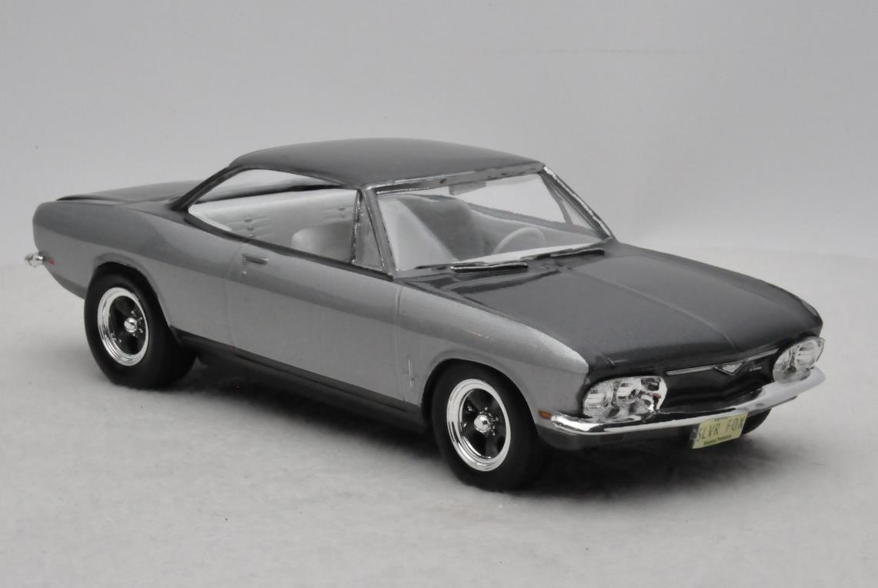
Second Place
Brent Marshall – Silver & Grey Corvair
Group 17
Round2 1969 Chevy Corvair

Slide 52
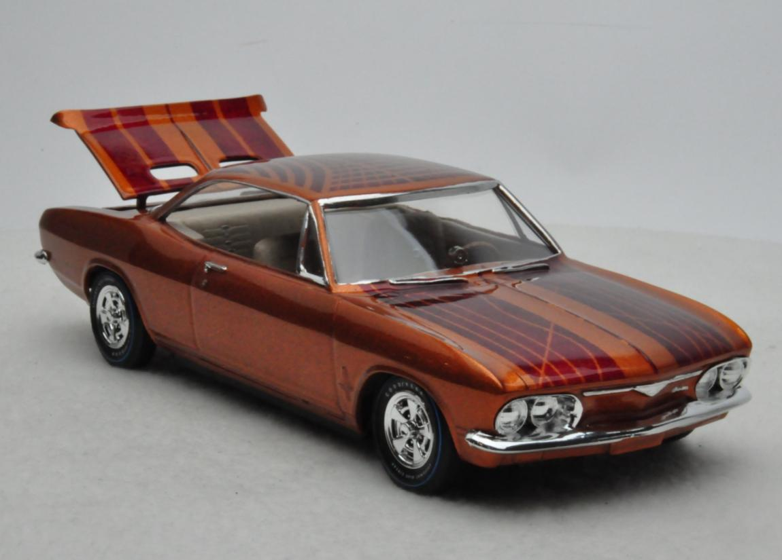
Best in Class
Jeff Bannan – Gold & Red Corvair
Group 17
Round2 1969 Chevy Corvair

Slide 53
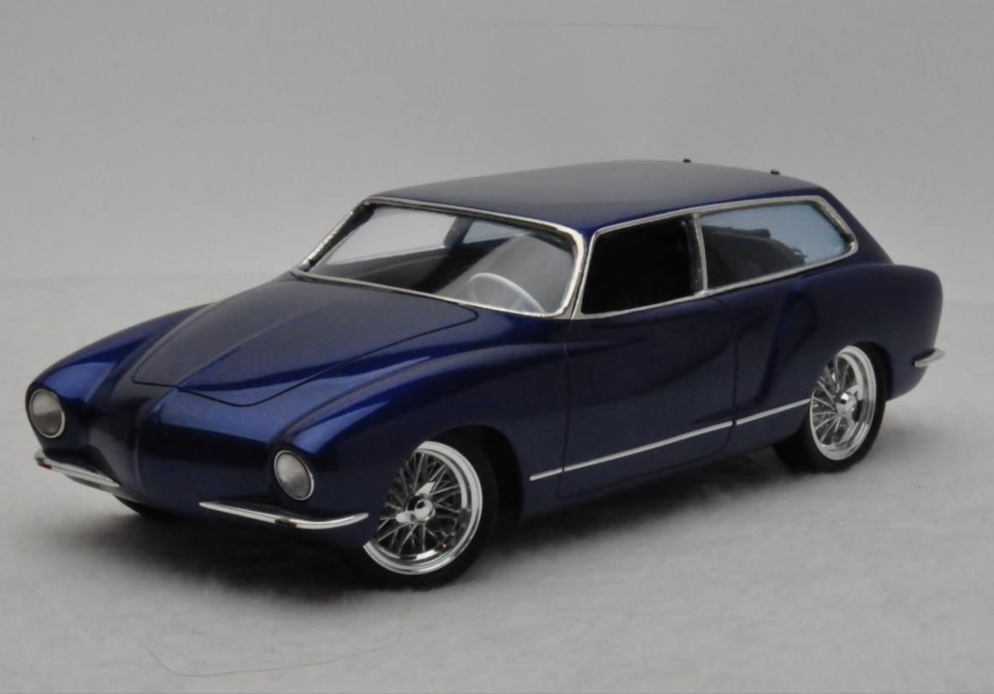
Best in Class
David Morton – Dark Blue Karman Ghia Wagon
“If I Had Styled It”

Slide 54
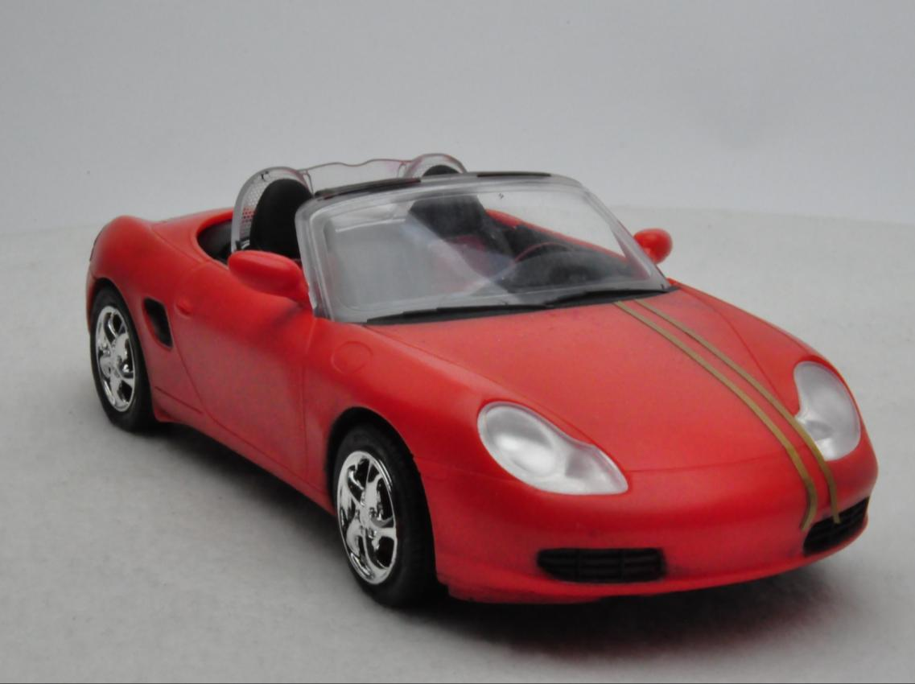
Third Place
A.J. Hadley – Orange Porsche Boxter
Junior

Slide 55
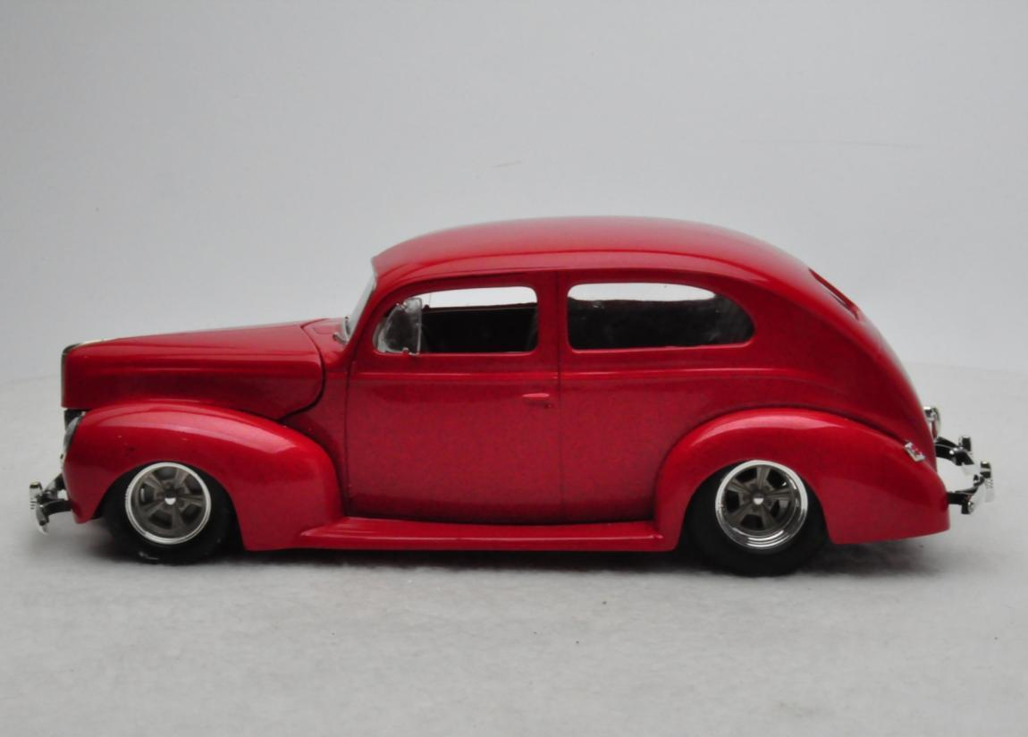
Second Place
Kody Bannon – Red 1939 Ford 2-Door Sedan
Junior

Slide 56
Best in Class
Kayden Brannon – Blue 1940 Ford Delux Coupe
Junior

Slide 57
Fourth Place
John Teresi – HD Knucklehead Drag Bike
Motorcycle

Slide 58
Third Place
John Teresi – Big Twin Trike
Motorcycle

Slide 59
Second Place
John Teresi – 1964 Triumph Custom
Motorcycle

Slide 60
Best in Class
Mike English – Honda 750-Four
Motorcycle

Slide 61
Fourth Place
Darren Dyk – Orange 1999 Camaro SS
Replica

Slide 62
Third Place
Len Woodruff – Freight Train Dragster
Replica

Slide 63
Second Place
John Teresi – Jeff Lindstrom’s 1930 Model A Gasser
Replica

Slide 64
Best in Class
David Morton – “Singled Out” Show Rig
Replica

Slide 65
Third Place
Art Laski – Pink Willys Gasser
Small Scale

Slide 66
Second Place
Simon P. Rivera-Torres – 1988 McLaren F-1
Small Scale

Slide 67
Best in Class
Simon P. Rivera-Torres – Blue Matra MS80
Small Scale

Slide 68
Fourth Place
Gary Kulchock – T-Bone
Specialty

Slide 69
Third Place
Jimmie Harris – 1966 Chevy Wagon Big Sister & the Zombie Stompers
Specialty

Slide 70
Second Place
John Teresi – Stagecoach
Specialty

Slide 71
Best in Class
Marty Kirk – International Scout Realistic Apocalypse Vehicle (No Zombies)
Specialty

Slide 72
Fourth Place
Dirk Joseph – Gold 1966 Nova
Street Machine

Slide 73
Third Place
Steve Keck – Black Cherry 1969 Camaro Pro-Touring
Street Machine

Slide 74
Second Place
Dirk Joseph – Dark Blue 1966 Chevelle
Street Machine

Slide 75
Best in Class
Charbel Perez – Blue Mini-Cooper
Street Machine

Slide 76
Fourth Place
Tyler Maughan – World War II Jeep
Street Rod

Slide 77
Third Place
Jimmie Harris – The Maltese Rat ‘32 Coupe
Street Rod

Slide 78
Second Place
John Z. Nichols – 1929 A Pick-up Surf Rod
Street Rod

Slide 79
Best in Class
Gary Kulchock – Binford Rat Rod
Street Rod

Slide 80
GSL Master Awards

Slide 81
Modeler’s Choice
Dave Morton – “The Singled Out” Show Rig
Master Award

Slide 82
Best Interior
Gary Kulchock – Binford Rat Rod
Master Award

Slide 83
Best Detail
Mike English – Honda 750-Four
Master Award

Slide 84
Best Paint/Finish
David Morton – Aston Martin DBS
Master Award

Slide 85
Dave Shuklis Engineering Award
Dave Morton – “The Singled Out” Show Rig
Master Award

Slide 86
Gerald Wingrove Scratchbuilding Award
Dirk Joseph – Top Fuel Bike
Master Award

Slide 87
Best of Show
Top three contenders

Slide 88
Best Of Show

Slide 89
Best of Show
Dave Morton – “The Singled Out” Show Rig
Master Award

